Slide 1
Artificial Intelligence: What is it and what can you do with it?
Ashim Gupta and Maitrey Mehta Advised by: Prof. Vivek Srikumar

Slide 2
Talk Outline
AI and Generative AI
Where we are and how we got here?
What Generative AI tools are available?
Risks & Pitfalls
What can Generative AI do for you?
Examples and case studies
Notes:
- Throughout this presentation, we’ll provide examples. These will be a mix of some general, fun examples and some related to specific use cases you might have as entrepreneurs.

Slide 3
AI and Generative AI

Slide 4
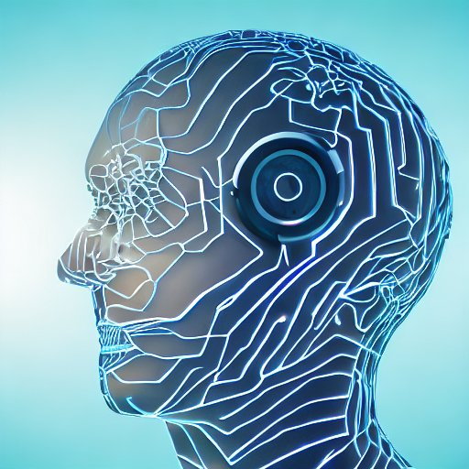
What is AI and Generative AI?
Artificial Intelligence: A program which mimics human-like intelligent behavior using computational means
Generative AI: Programs which generate text, images, speech, etc. from input textual prompts
Example tools to generative AI:
Generate Text: ChatGPT, Google Bard
Generate Images: DALL-E, Stable Diffusion
This image (and the one on the previous slide) was generated by Stable Diffusion for the prompt "Generative AI"
Notes:
AI can do translation, playing chess, generating images etc. But ut yet cannot do fully autonomous driving, babysitting, etc. Generative AI typically uses text description a.k.a. prompts

Slide 5
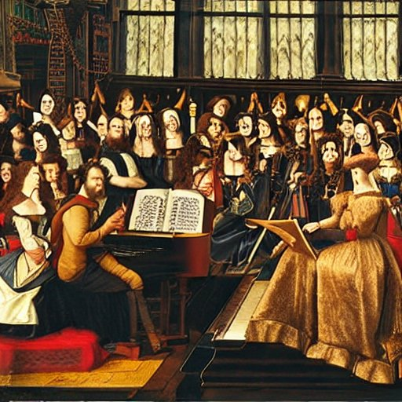
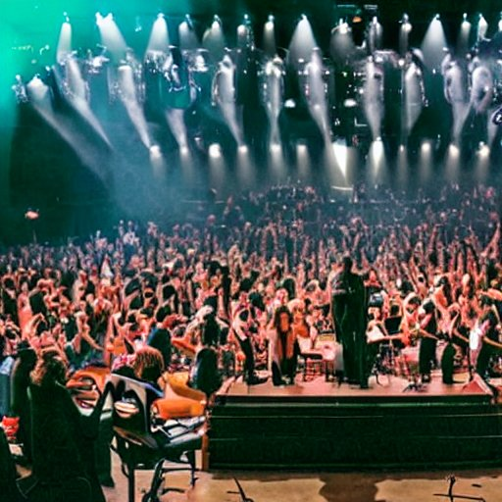
A music concert in the ...
1500s
1800s
2000s

Slide 6
Where we are and how we got here?

Slide 7
Where are we?
Consider a text generative AI model like ChatGPT
A chatbot like system capable of producing reasonable texts
Exposed to gargantuan amount of text
ChatGPT learns patterns in the text
How does it do it ?!!

Slide 8
A boring game
Pick a random book from a library
Pick a random sentence from it
Hide the ending of the sentence Ask another person to complete it
Will they get the right completion?
A plausible completion?
A grammatically correct one?
Image Generation models are similar just that they generate blocks of pixels instead of text
Text generation models have gone gotten better over the years at this game Models like ChatGPT are currently the best at it.
Notes:
We will not talk more about technical but instead we’ll look at tools which are more relevant to you.

Slide 9
What Generative AI tools are available?

Slide 10
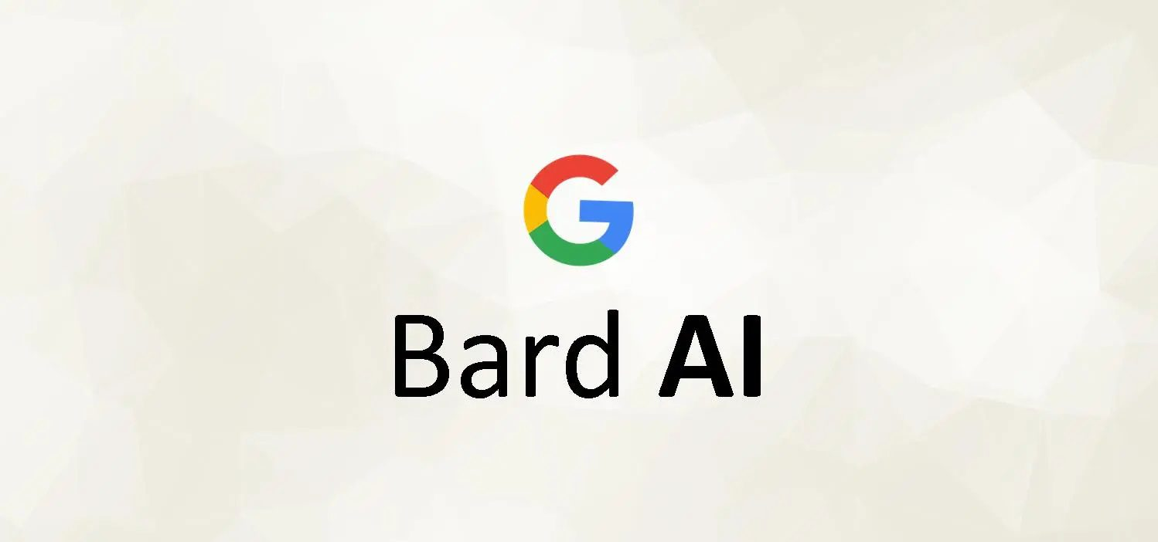
Tools Available
Use prompts to generate text
Use prompts to generate images
Convert speech to text
Use prompts to edit images
Stable Diffusion
MidJourney

Slide 11
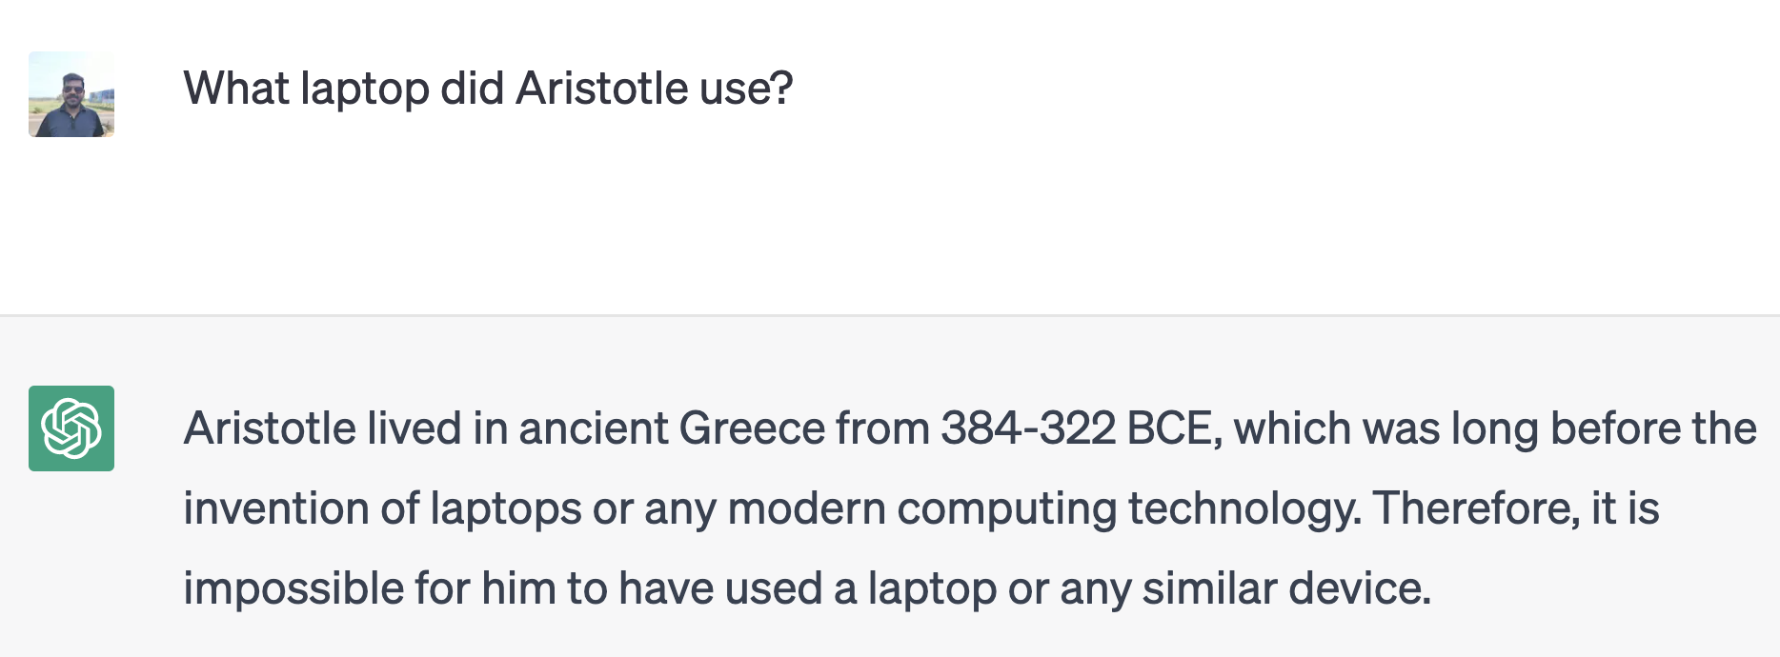
Use prompts to generate text
Poem about dogs
Aristotle used laptop?

Slide 12
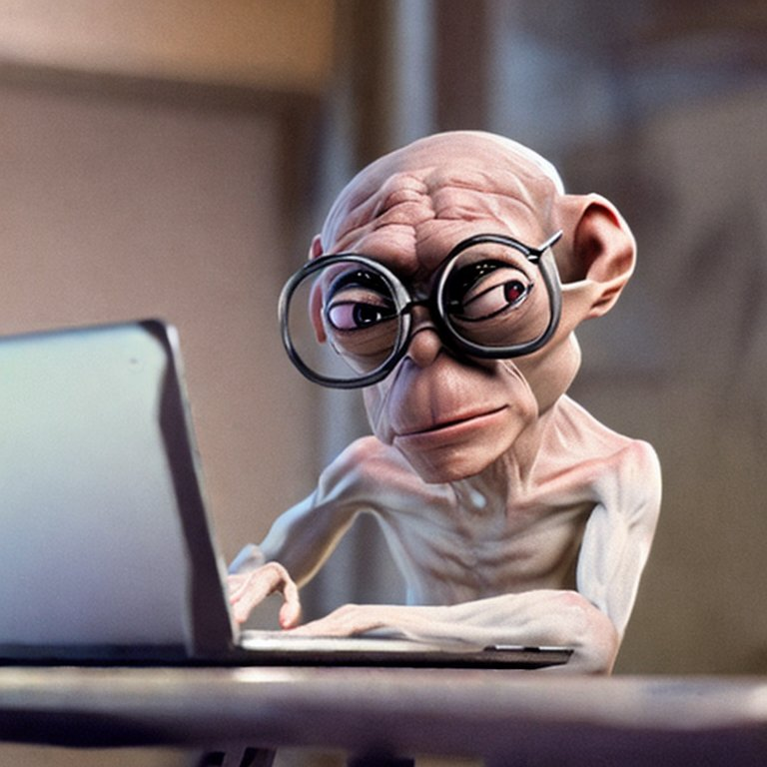
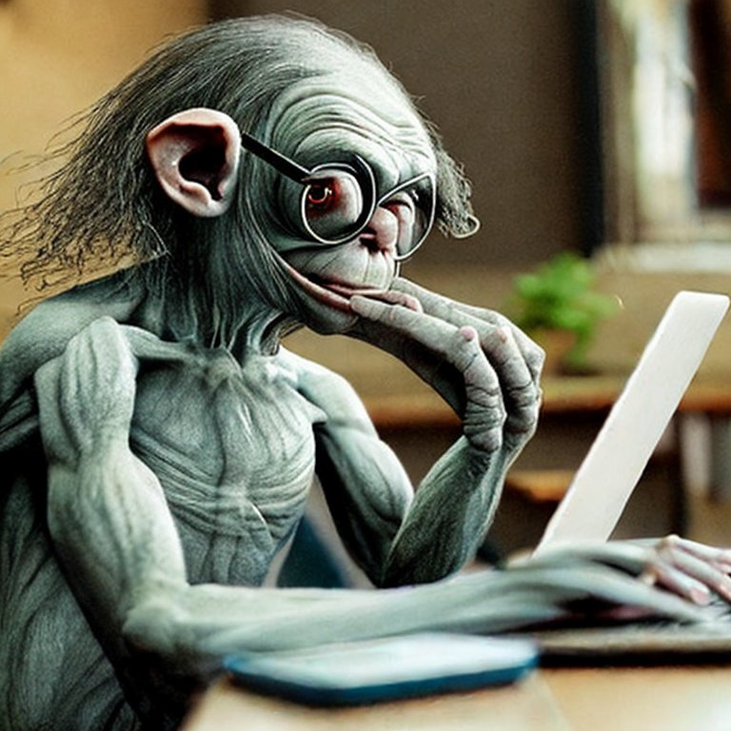
Use prompts to generate images
Prompt: "Gollum wearing glasses and working on a laptop "
Generated from : https://huggingface.co/spaces/stabilityai/stable-diffusion

Slide 13
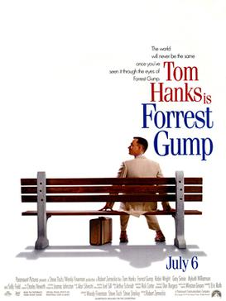
Convert speech to text
Whisper Generated: "My mom always said life was like a box of chocolates. You never know what you're going to get."
"Life is like a box of chocolates.mp3"
Generated from : https://huggingface.co/openai/whisper-base

Slide 14
Use prompts to edit images
Prompt: Add a flamingo beside the pool
Image Courtesy: https://openai.com/product/dall-e-2

Slide 15
Access to Tools
Tool | Generates | Web Interface | Programmatic Access
ChatGPT | Text
GPT-4 | Text
DALL-E 2 | Images
Whisper | Text
Bard | Text
Stable Diffusion | Images
MidJourney | Images

Slide 16
Risks & Pitfalls

Slide 17
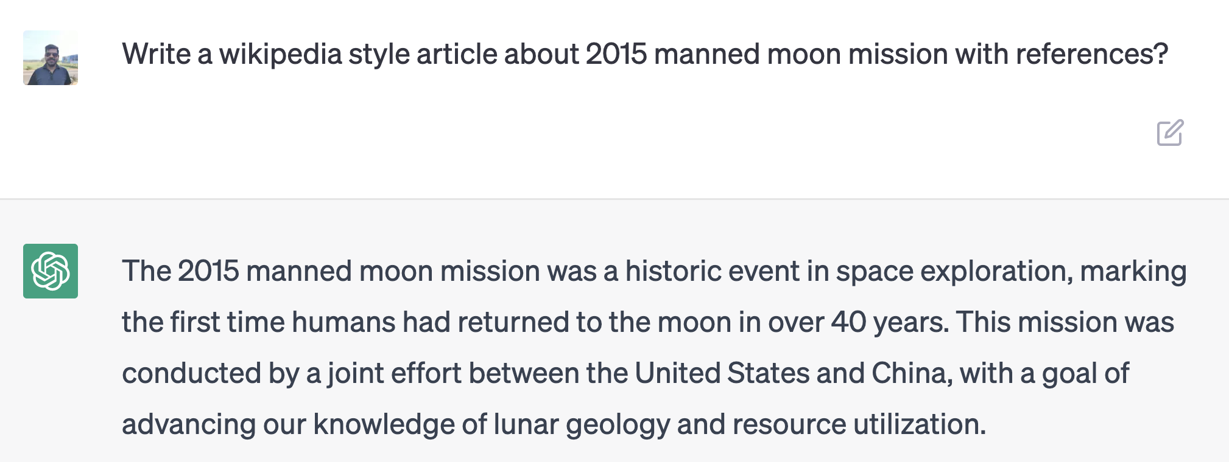
Risks & Pitfalls
Don’t trust everything it generates
⚠️
Image from. https://www.buzzfeednews.com/article/chrisstokelwalker/pope-puffy-jacket-ai-midjourney-image-creator-interview

Slide 18
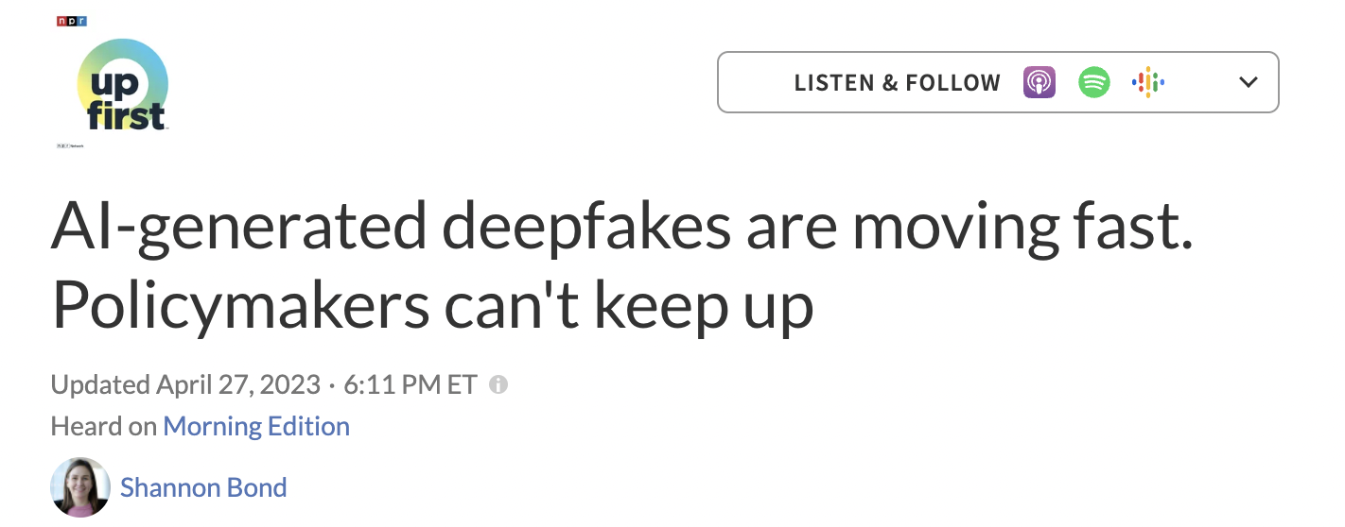
Risks & Pitfalls: Misinformation
⚠️
⚠️
⚠️
⚠️
TL: https://www.npr.org/2023/04/27/1172387911/how-can-people-spot-fake-images-created-by-artificial-intelligence
TR: https://www.euronews.com/next/2023/05/02/rapid-growth-of-news-sites-using-ai-tools-like-chatgpt-is-driving-the-spread-of-misinforma
BL: https://www.nytimes.com/2023/02/08/technology/ai-chatbots-disinformation.html
BR: https://www.wsj.com/articles/readers-beware-ai-has-learned-to-create-fake-news-stories-11571018640

Slide 19
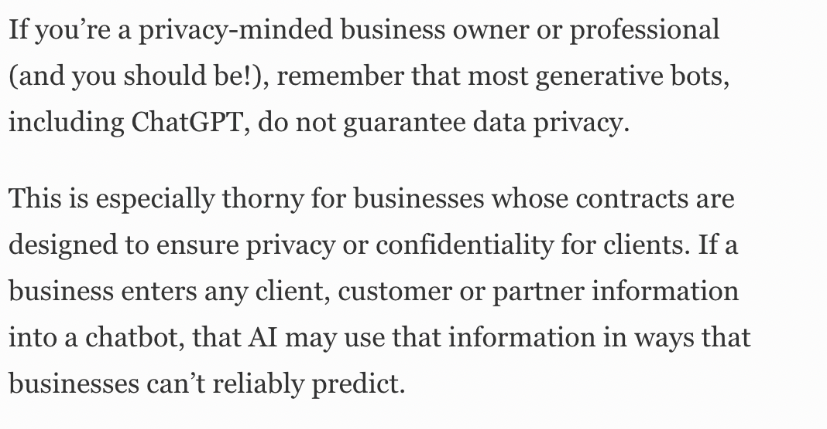
Risks & Pitfalls: Privacy
⚠️
Article: https://www.forbes.com/sites/forbesbusinesscouncil/2023/05/01/how-generative-ai-can-affect-your-business-data-privacy/?sh=5390c364702d

Slide 20
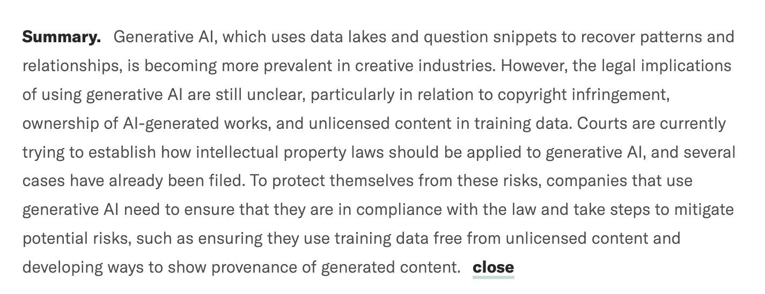
Risks & Pitfalls: Copyright
⚠️
Article: https://hbr.org/2023/04/generative-ai-has-an-intellectual-property-problem

Slide 21
What can Generative AI do for you?
Notes:
Thank you Maitrey! Thanks to the organizers again for the opportunity! I am going to talk about: What can AI do for you?

Slide 22
What can Generative AI do for small businesses?
Benefits of Generative AI for Small Businesses
Creates personalized content for customers
Automates customer service with chatbots or virtual assistants
Streamlines operations by automating routine tasks
Enhances product design with AI-generated designs
Analyzes customer data to generate insights
You don’t have to trust me on this. This content was generated by ChatGPT!
Notes:
These are some of the ways you can use Generative AI for your respective businesses.
For instance, you can use it for creating personalized content for customers or even analysing data to generate insights.
While creating this slide, I wanted to get some ideas and I asked a friend, and that friend is ChatGPT
[Click]
Just like I used chatGPT for generating this list, you can use it too. And let us see how.
[Click]

Slide 23
What is Good Prompting?
What are Bad Prompts?
Notes:
Most of these models rely on a textual input called prompts. We need good prompts to enable them to produce the desired outputs - be it image or text.
And to understand what are good prompts, we will first look at what are bad prompts.
Here I have an example where I use chatGPT as a dream interpreter. I want it to interpret a strange dream I had about a giant spider chasing me.

Slide 24
What is Good Prompting?
What are Bad Prompts?
Vague, unspecific prompts
About fear
Creativity, patience
Feminine energy and power
General, non-committal response

Slide 25
What is Good Prompting?
A more specific prompt …
More details: what it should and shouldn’t do
Notes:
- Here I re-write that prompt to provide more details on what it should and should not do.
Now lets take a look at the response.

Slide 26
What is Good Prompting?
A more specific prompt …
More details: what it should and shouldn’t do
Concise and focused on a single point

Slide 27
Anatomy of a Good Prompt
The persona to adopt
I want you to act as a dream interpreter. I will give you descriptions of my dreams, and you will provide interpretations based on the symbols and themes present in the dream. Do not provide personal opinions or assumptions about the dreamer. Provide only factual interpretations based on the information given. My first dream is about being chased by a giant spider.
Notes:
- Now let us dissect that prompt and see why it worked better.

Slide 28
Anatomy of a Good Prompt
The persona to adopt
I want you to act as a dream interpreter. I will give you descriptions of my dreams, and you will provide interpretations based on the symbols and themes present in the dream. Do not provide personal opinions or assumptions about the dreamer. Provide only factual interpretations based on the information given. My first dream is about being chased by a giant spider.
How to respond? The task description
Notes:
- Add different colors to text highlights

Slide 29
Anatomy of a Good Prompt
The persona to adopt
I want you to act as a dream interpreter. I will give you descriptions of my dreams, and you will provide interpretations based on the symbols and themes present in the dream. Do not provide personal opinions or assumptions about the dreamer. Provide only factual interpretations based on the information given. My first dream is about being chased by a giant spider.
How to respond? The task description
How not to respond?
Notes:
- Add different colors to text highlights

Slide 30
Anatomy of a Good Prompt
The persona to adopt
I want you to act as a dream interpreter. I will give you descriptions of my dreams, and you will provide interpretations based on the symbols and themes present in the dream. Do not provide personal opinions or assumptions about the dreamer. Provide only factual interpretations based on the information given. My first dream is about being chased by a giant spider.
How to respond? The task description
How not to respond?
What type of information is needed?
Notes:
- Add different colors to text highlights

Slide 31
Anatomy of a Good Prompt
The persona to adopt
I want you to act as a dream interpreter. I will give you descriptions of my dreams, and you will provide interpretations based on the symbols and themes present in the dream. Do not provide personal opinions or assumptions about the dreamer. Provide only factual interpretations based on the information given. My first dream is about being chased by a giant spider.
How to respond? The task description
How not to respond?
What type of information is needed?
The example.
Notes:
- Add different colors to text highlights

Slide 32
Anatomy of a Good Prompt - Example
Concise and focused on a single point
Notes:
About fear and anxiety.
Now we have learnt how to make good prompts. Going forward, we will present a few case studies where we apply these principles.
These case studies will be especially useful for you.

Slide 33
Case Study 1
Notes:
- Most case studies we will look at are use chatGPT but you can also you other tools like Google’s Bard.

Slide 34
Using ChatGPT to Write E-mails
As an owner of a footwear company – Introducing a new line of Sneakers
Notes:
- We mention that email should be formal and not longer than five sentences.

Slide 35
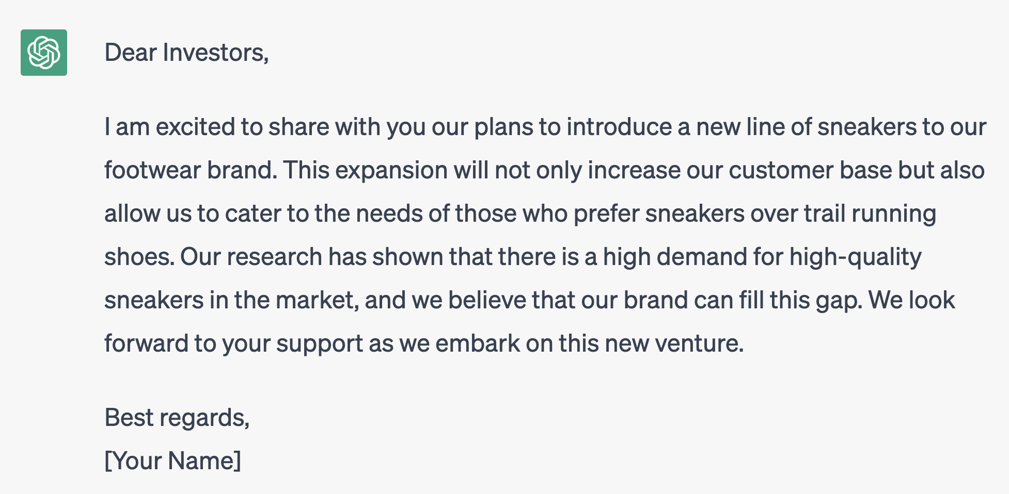
ChatGPT Response
Email to the Investors
Formal tone
Response less than 5 sentences
Generated from: https://chat.openai.com/

Slide 36
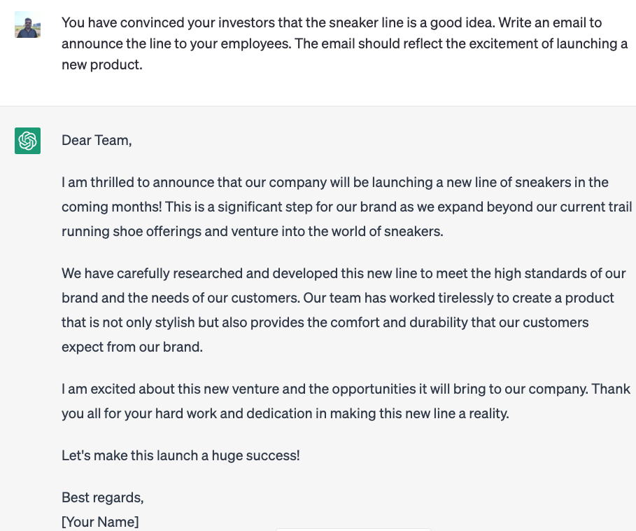
My follow-up question: Announce to the team
Email to the Employees
Reflects excitement

Slide 37
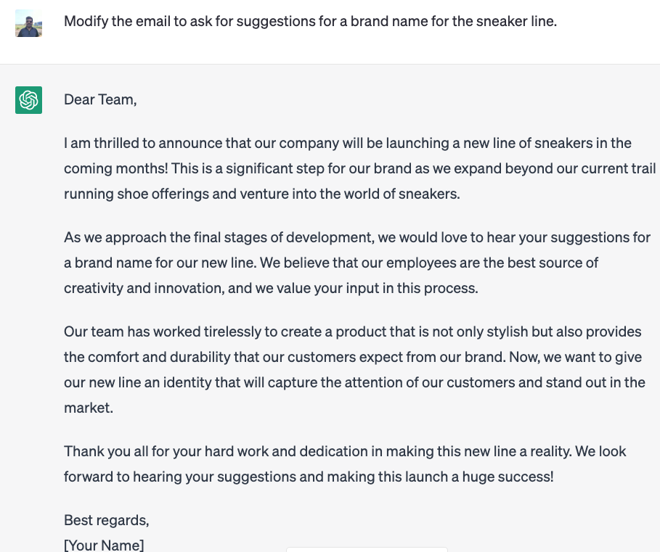
My follow-up question: Announce to the team and ask Suggestions for a Brand Name
Email to the Employees
Generated from: https://chat.openai.com/
Preserves the sentiment

Slide 38
Case Study 2

Slide 39
Using ChatGPT for Market Research
Where to place food trucks?

Slide 40
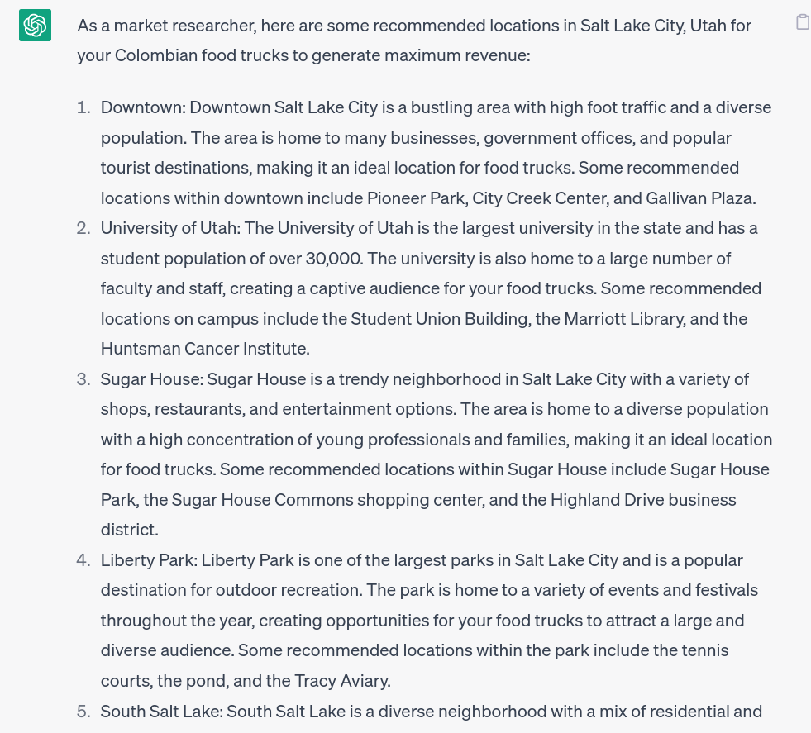
ChatGPT Response
Food Trucking Locations

Slide 41
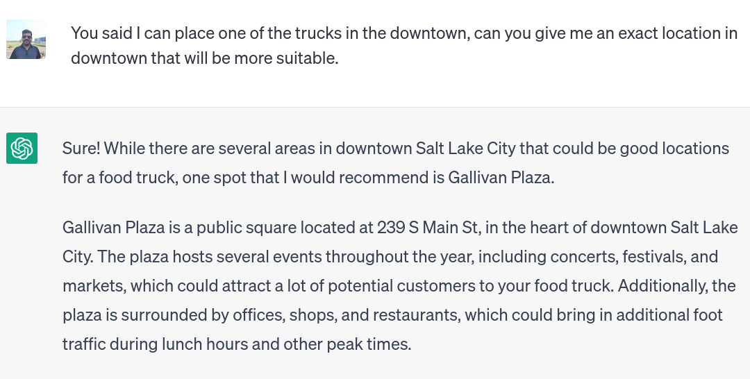
My follow-up question: One location in Downtown
Food Trucking Locations
Its response: Gallivan Plaza and Why?

Slide 42
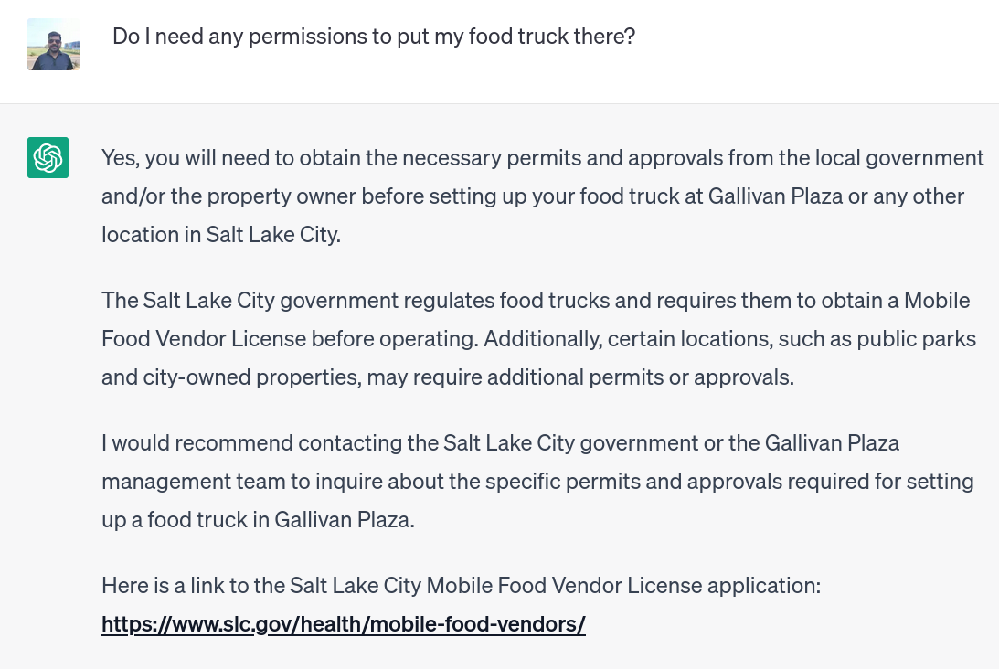
Another question: Any permissions required?
Food Trucking Locations
Its response: Yes, talk to management

Slide 43
Case Study 3

Slide 44
Using ChatGPT for as a Social Media Manager
Generating a social media post
Notes:
When I created this example, I made a typo in the last word, and as we will see such small mistakes do not matter.

Slide 45
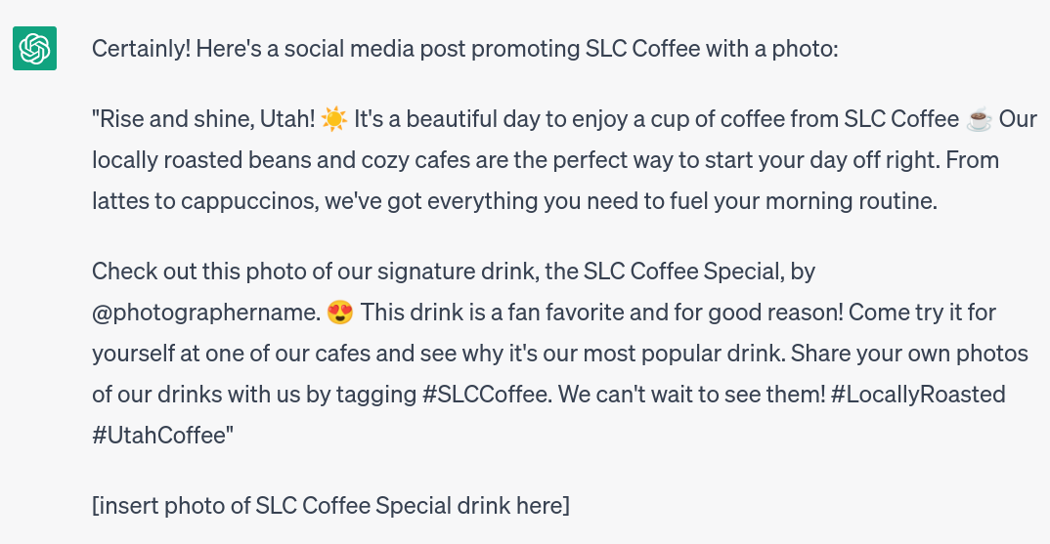
ChatGPT Response
Social Media Post

Slide 46
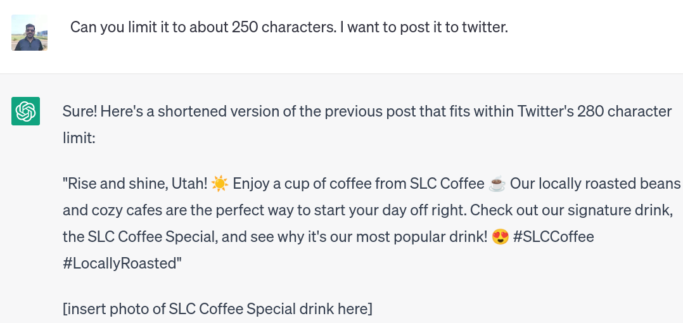
My follow-up: Modify for Twitter
Social Media Post
Its response: A smaller post
Notes:
- I gave a character limit of 250 characters and it points out that the limit for twitter is 280 characters. - As you notice from the line, it asks us to use a photo of a coffee. Now lets, say we have a photo and we want to make it better - using Generative AI

Slide 47
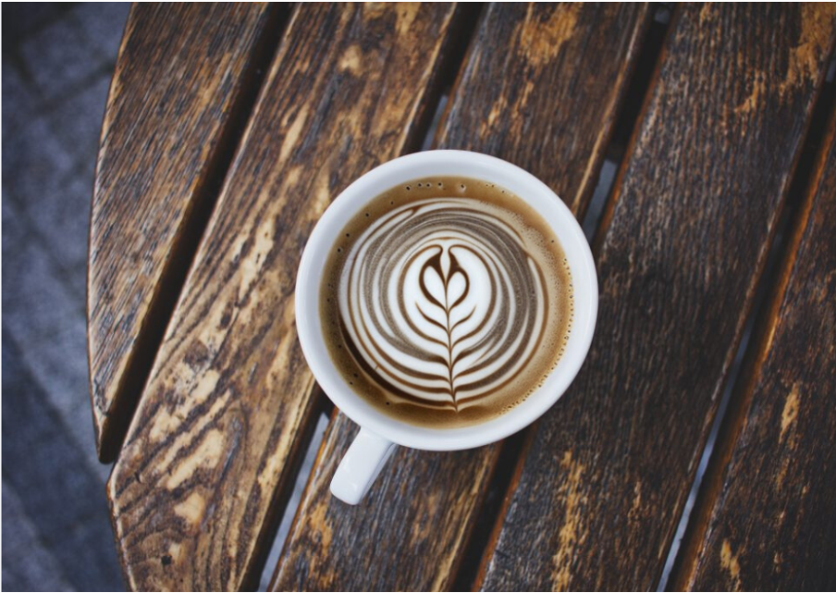
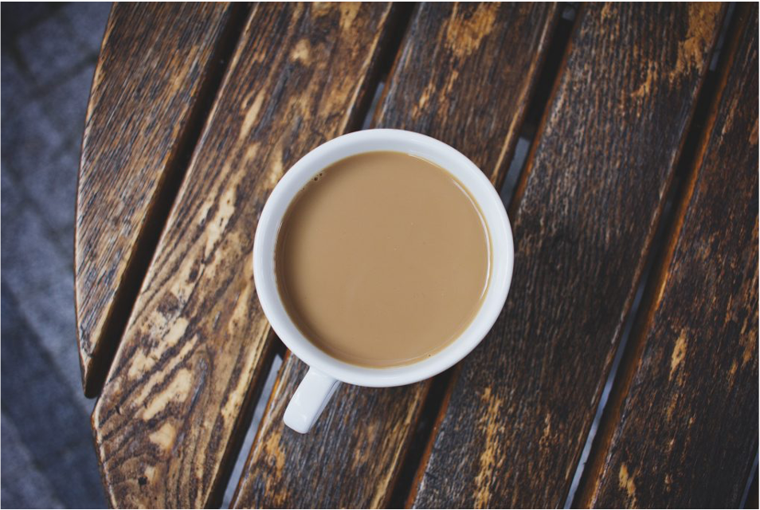
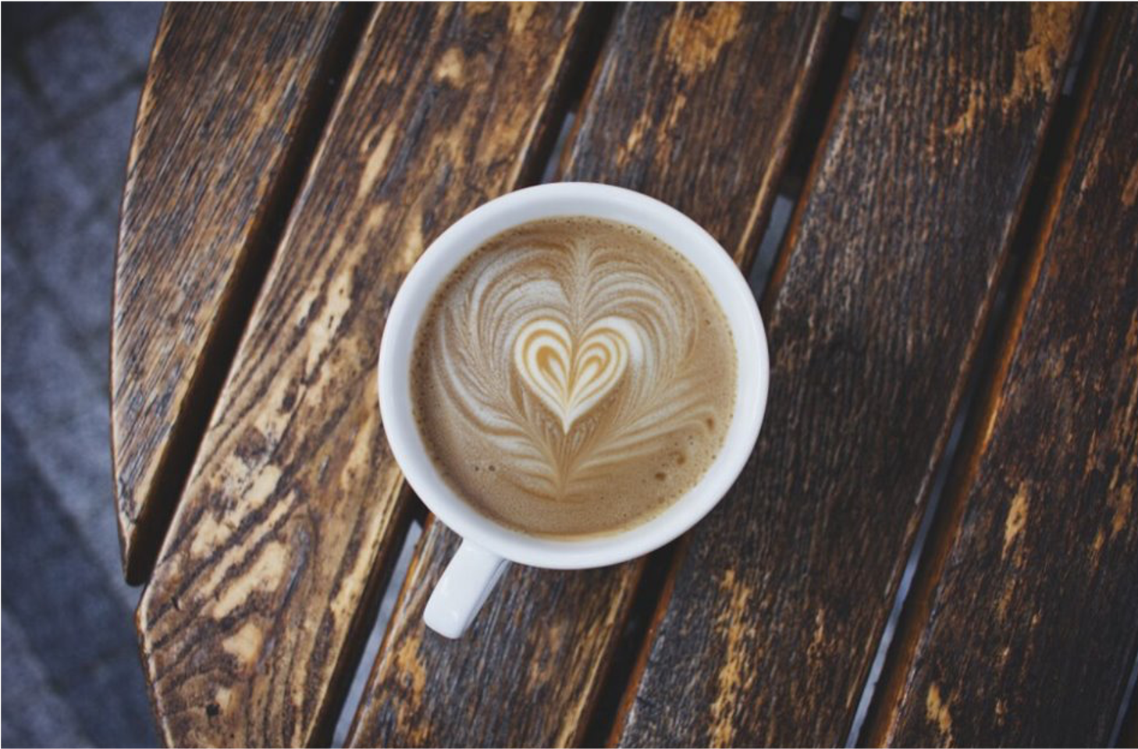
What about the Photo …
Edited using Canva: https://www.canva.com/ with prompt "Add Latte Art"
Notes:
Mention that you can explore other alternatives like Bard as well

Slide 48
What else can Generative AI do for you?
Summarizing the product reviews
Creating a description from a product fact sheet
Craft replies to customer queries/reviews online
Brainstorming product ideas
Notes:
Mention that you can explore other alternatives like Bard as well

Slide 49
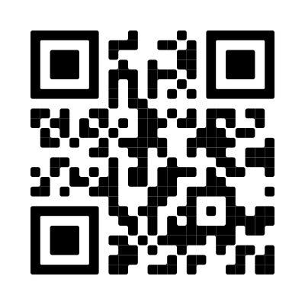
Final Words
Slides available @
We talked about:
Generative AI: Promises and Perils
How to create good prompts?
How small businesses can use Generative AI?
Specific case studies for business owners
Thank you!
Notes:
This talk, put a QR code. You can access

